Slide 1

Platform 4
Eastern Partnership
Eastern Partnership Civil Society Forum, WG 4
15 June 2016
Kamila PARTYKA, Platform 4 Coordinator

Slide 2
Eastern Partnership Platform 4
« Contacts between People »
Covers a wide range of issues which are:
common to a large number of citizens: education, training, research and innovation, information society, youth, culture and media
instrumental for the prosperity and stability of our societies and contribute to growth, development and job creation
support civil society development

Slide 3
Eastern Partnership Platform 4
« Contacts between People »
Offers a balance of
    reinforced policy dialogue
    strengthened participation in EU programmes

Slide 4
Revised Work Programme 2014-2017
Adopted on 7 June 2016
Guided by the joint declarations of the Eastern Partnership Summits
Take into account the revised European Neighbourhood Policy
Seek to exploit synergies between the different multilateral Platforms (cf. new youth employability panel)
Measurable impacts, reinforced focus, flexibility in implementation

Slide 5
Calendar of EaP Platform 2016-2017
 | Specific focus | Date | Location
15th EaP Platform 4 | Tackling skills mismatch of graduates from higher education and vocational education and training | 7 June 2016 | Brussels
16th EaP Platform 4 |  | November 2016 | Brussels
17th EaP Platform 4 |  | Summer 2017 | Brussels
18th EaP Platform 4 | New Workprogramme, tbc | Autumn 2017 | Brussels

Slide 6
Panel on Research and Innovation
 | Date | Location
4th Panel on Research and Innovation | Second semester 2016 | Brussels
One regional event per year and complementing the work of the Panel on Research and Innovation and the activities carried out in the framework of the INCONET EaP on topics such as: - issues related to cooperation in the innovation domain - specific S&T capacity issues faced by Eastern Partnership countries | 2017 – annual regional event to be hosted by Belarus | Minsk, Belarus
5th Panel on Research and Innovation | 2017 | Brussels

Slide 7
Provisional list of events 2016
Title | Organised by | Date | Location
Validation workshop of the Study on Film industries | DG Connect | 21 -22 July 2016 | Odessa
Conference: "Youth for Rights" | CSF | 23 September 2016 | Bratislava
Seminars/workshops: eInfrastructures | DG Connect | 6-7 October 2016 | Tbilisi
Workshop on creative industries, possible focus on creative cities/decentralized cultural policies | DG EAC | 2016 (tbc) | Moldova
5th Meeting of Marie Skłodowska-Curie actions National Contact Points: provision of support to facilitate the participation of EaP representatives | DG EAC | November 2016 | Brussels
Seminars/workshops : ICT in Horizon 2020 | DG Connect | Autumn 2016 | tbd
Seminar on integrity in higher education | DG EAC | Autumn 2016 | Brussels
EaP Forum on “Culture and Creative Industries” | Georgia | 8-9 December 2016 | Tbilisi
Regional Torino Process 2016 | European Training Foundation | December 2016 | Tbilisi

Slide 8
EaP Platform 4: Higher Education
EU Agenda for Modernisation of Higher Education
Globalisation and digitalisation require new skills and greater adaptability
3 Key priorities:
  High-level skills
  Strengthening the research base
  Regional development and innovation

Slide 9

Higher education
cooperation opportunities
Academic mobility
Jean Monnet Activities
Capacity Building for HE
Degree mobility
EMJMD
International credit mobility
Academic cooperation

Slide 10


International Credit Mobility
439 EU-EaP projects selected in 2015
~4.400 EU-EaP mobilities expected by 2017 (~50% of them with UA)
In 2016, 886 applications received (22.5% increase); 2nd round open to 10 NAs (€ 1.8 Mio)
Notes:
Some 1800 students and staff from Ukraine will come to study, teach or train in a Programme Country in Europe between now and 2017
Nearly 400 European students will go to study in Ukraine
In comparison, in the overall financing period 2007-2013, 1500 students or scholars from Ukraine received funding for mobility, indicating a sharp increase of this type of mobility under Erasmus+.
Under the 2016 call, 307 applications were submitted for projects with Ukraine requesting a total of 8000 individual mobilities, a 33% increase since last year.

Slide 11

Degree mobility – Erasmus Mundus Joint Master Degrees
Excellence and high level of integration of the joint study programmes
85 EaP students + 10 doctoral candidates supported in 2014-2015 (UA accounts for ~50% of scholarships)
Initial results for 2016 intake: 66 students and 6 doctoral candidates
Notes:
Overall good results of UA
In 2016, UA receives some 55% of scholarships offered to Eastern Partnership countries

Slide 12

Joint and Structural Projects
23 projects selected in 2015 involving ~90 HEIs from EaP
148 intra-region and 90 cross-regional applications submitted in 2016 call (results expected in July)
Capacity Building

Slide 13


Jean Monnet Activities
Policy debate with academic world
Support to institutions & associations
Excellence in teaching & research in EU studies
31 Jean Monnet Activities
selected in EaP
Notes:
The aim is to promote excellence in teaching and research in the field of European Union studies worldwide (Modules, Chairs, Centres of Excellence).
The actions foster the dialogue between the academic world and policy-makers, in particular with the aim of enhancing governance of EU policies (Networks, Projects).
Jean Monnet provide also support to institutions that enhance teacher and training activities and associations that contribute to the study of the European integration process.

Slide 14
EaP Platform 4: Youth
Strong focus of the 2015 ENP review
Youth Employment and Employability dialogue to be set up under the EaP Platform 2 – synergies with Platform 4
New intiatives: EU4Youth, Erasmus+ Virtual Exchanges
Set of measures on Addressing radicalisation leading to violent extremism (Commission Communication of 14/06/2016)
EaP events: CSF Conference in Sept 2016, Youth Forum in 2017

Slide 15
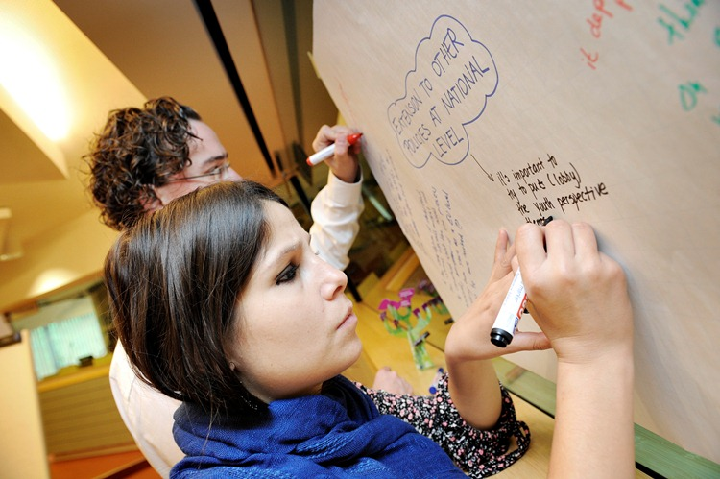
Opportunities for young people
Erasmus+ mobility, exchanges, voluntary service and policy dialogue
In 2015, nearly 7000 young people and youth workers from EaP supported under Erasmus+ Youth strand
Notes:
In line with the EU Youth Strategy 2010-2018, the EU supports international non-formal learning activities of young people and youth workers to foster young people's participation in democratic life and the labour market.
In this context, the EU contributes to developing the quality of youth work and supports youth policy reform.

Slide 16
EaP Platform 4:
Research and Innovation
Association Agreements to Horizon 2020
  Georgian Association Agreement signed on 29 April 2016, provisionally applicable as from 1 January 2016
  Armenian Association Agreement signed on 19 May 2016, entry into force will follow ratification
GE and AM Launch events: 30-31 May in Tbilisi and 2-3 June in Yerevan
Policy Support Facility: MD - document being finalised; UA - launched

Slide 17

H2020
Marie Skłodowska-Curie actions
Research training, mobility, networking and career development
So far, 128 MSCA fellowships awarded to EaP researchers
43 EaP research institutions involved in MSCA projects (mainly RISE); € 4.87 Mio EU contribution
Notes:
The Marie Skłodowska-Curie actions (MSCA) invest € 6.2 billion (2014-2020) in the researchers to deliver on innovation, growth and participation in a modern society.
The MSCA are a strong and recognised instrument to develop competences relevant for the economy, with a proved track record of success in boosting excellence in research, enhancing employability of researchers and contributing to their greater career progression.

Slide 18
EaP Platform 4: Information Society
E@P.Connect project to connect electronically all EaP countries through GÉANT network
Enable researchers and students to participate in collaborative work with their peers in Europe
First milestone achieved in Q1 2016: AM and GE connected
First EaP E-Infrastructure Conference to take place in Tbilisi on 6-7 October 2016

Slide 19
EaP Platform 4: Culture
Towards an EU strategy for international cultural relations (Joint EEAS and Commission Communication of 08/06/2016)
3 work streams to advance international cultural relations with partner countries:
  Supporting culture as an engine for sustainable social and economic development
  Promoting culture and intercultural dialogue for peaceful inter-community relations
  Reinforcing cooperation on cultural heritage

Slide 20
Culture: EU Programmes
Creative Europe: 3 EaP countries joined the programme (GE, MD, UA)
Eastern Partnership Culture Programme II implemented since January 2015 (3 years; € 4.9 Mio)
COMUS project to develop local development strategies for the historic centres of 9 EaP cities

Slide 21
EaP Platform 4 of 7 June 2016
Focus on Skills development
New Skills Agenda for Europe (Commission Communication of 10/06/2016)
3 key priorities:
  Improving the quality and relevance of skills formation
  Making skills and qualifications more visible and comparable
  Improving skills intelligence and information for better career choices

Slide 22
EaP Platform 4 of 7 June 2016
Focus on Skills development
Focus of the EaP P4 meeting: tackling skills mismatch in HE and VET
Common objectives:
  Improved quality and relevance of education and training
  Skills to better match labour market needs
  Available information for better career choices

Slide 23
Further information
Send us an e-mail :EAC-PLATFORM-4-EASTERN-PARTNERSHIP@ec.europa.eu
Eastern Partnership Platform 4 on the web :
http://ec.europa.eu/dgs/education_culture/international/eastern_en.htm
Information about European Neighbourhood Policy
http://ec.europa.eu/enlargement/about/directorate-general/index_en.htm
and in particular on Eastern Partnership
http://ec.europa.eu/enlargement/neighbourhood/eastern-partnership/index_en.htm
under the website of the European External Action Service
http://eeas.europa.eu/eastern/index_en.htm

